Slide 1
STELLA and Calculus
STELLA numerically simulates the solutions to systems of differential equations.
STELLA INTEGRATES!

Slide 2
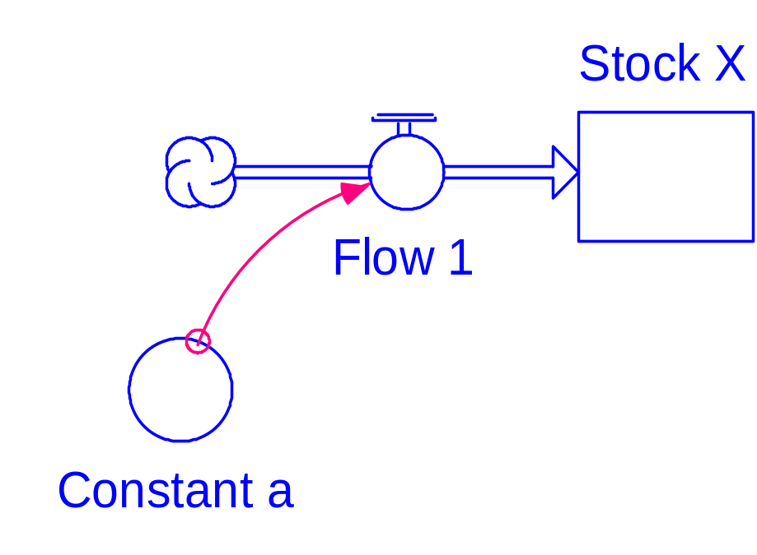
Calculus Example 1
STELLA Diagram
Flow is constant.
STELLA Equations:
Stock_X(t) = Stock_X(t - dt) + (Flow_1) * dt
  INIT Stock_X = 100
  Flow_1 = Constant_a
  Constant_a = 10

Slide 3
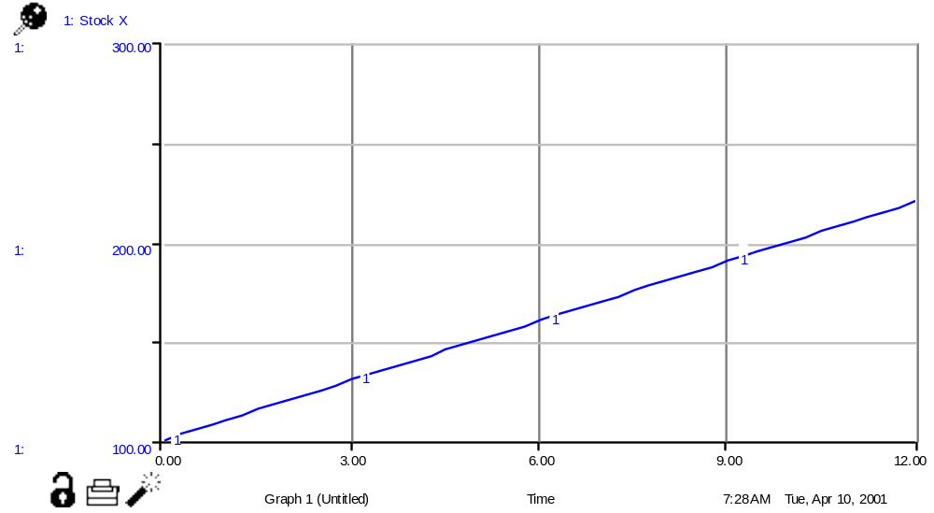
Example 1 Graph

Slide 4
Question?
Does the graph have an equation?
“Obviously”
X = 10t + 100

Slide 5
Differential Equation 1
Stock_X(t) = Stock_X(t - dt) + (Flow_1) * dt
(Stock_X(t) - Stock_X(t - dt))/dt = Flow_1
    Flow_1 = Constant_a
(X(t) - X(t - dt))/dt = a
    let dt 0
dX/dt = a (a differential equation)
Solution to DE:
X = at + X(0)

Slide 6
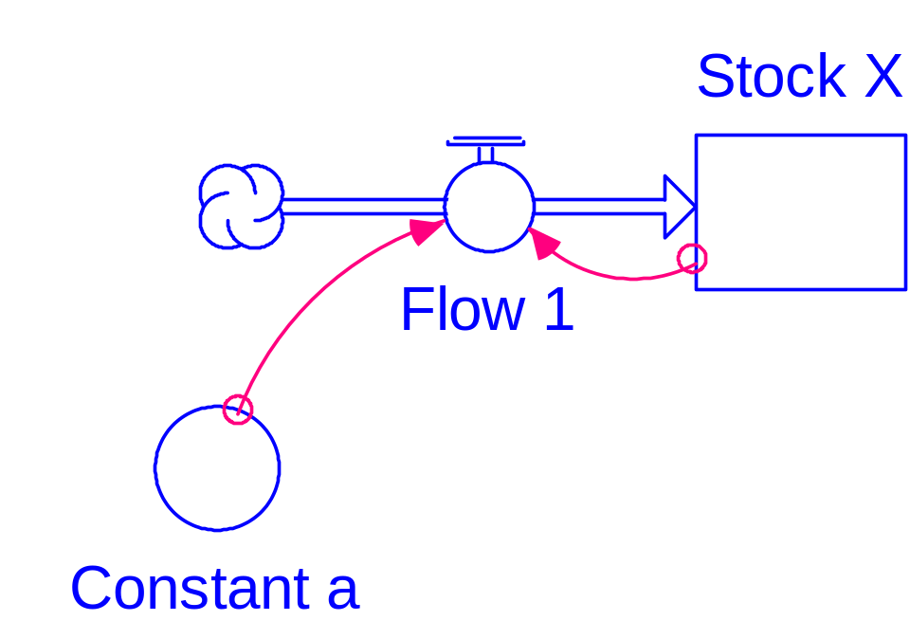
Calculus Example 2
STELLA Diagram
Flow is proportional to X.
STELLA Equations:
Stock_X(t) = Stock_X(t - dt) + (Flow_1) * dt
  INIT Stock_X = 100
  Flow_1 = Constant_a*Stock_X
  Constant_a = .1

Slide 7
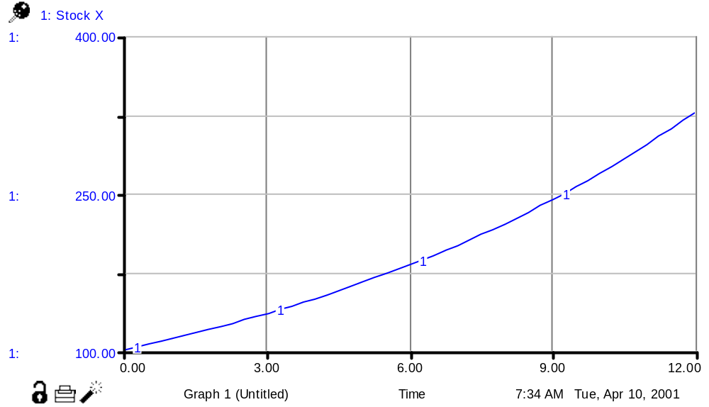
Example 2 Graph

Slide 8
Differential Equation 2
Stock_X(t) = Stock_X(t - dt) + (Flow_1) * dt
(Stock_X(t) - Stock_X(t - dt))/dt = Flow_1
    Flow_1 = Constant_a*Stock_X
(X(t) - X(t - dt))/dt = aX(t-dt)
dX/dt = aX (differential equation)
Solution to DE:
X = X(0) exp(at)

Slide 9
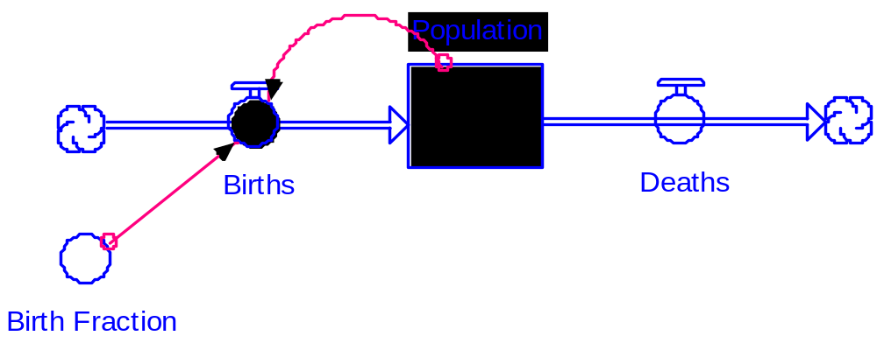
Calculus Example 3
STELLA Diagram
Two flows, an inflow and an outflow.

Slide 10
STELLA Equations 3
Stock_X(t) = Stock_X(t - dt) + (Flow_1 - Flow_2) * dt
    INIT Stock_X = 1000
Flow_1 = Constant_a*Stock_X(t-dt)
Flow_2 = Constant_b
    Constant_a = .11
    Constant_b = 100

Slide 11
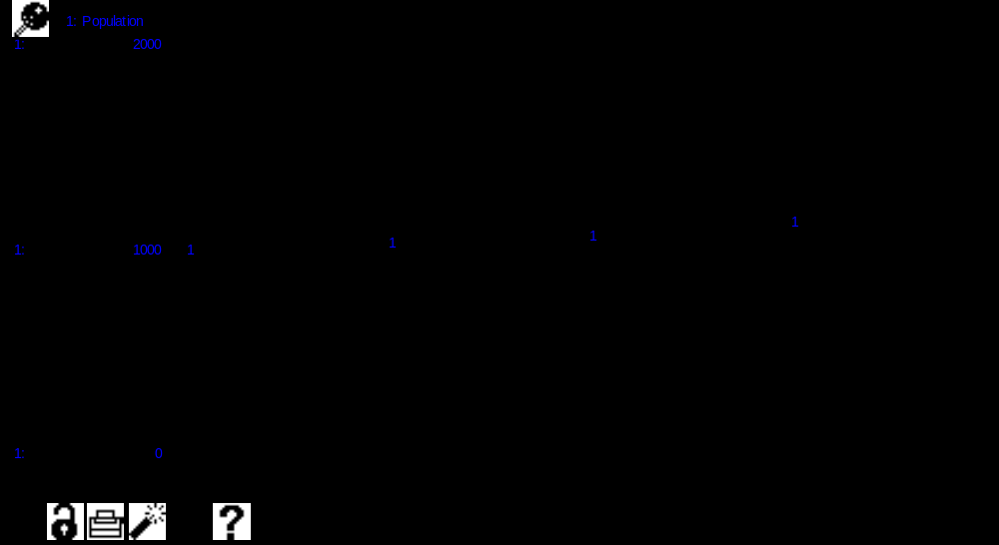
Example 3 Graph

Slide 12
Differential Equation 3
Stock_X(t) = Stock_X(t - dt) + (Flow_1 - Flow_2) * dt
(Stock_X(t) - Stock_X(t - dt))/dt = Flow_1 - Flow_2
    Flow_1 = Constant_a*Stock_X(t-dt)
    Flow_2 = Constant_b
dX/dt = aX - b
Solution to DE:
?

Slide 13
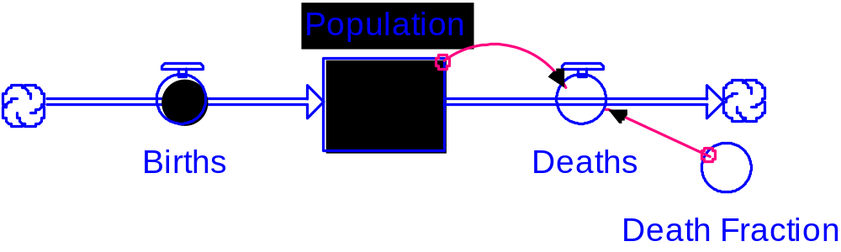
Calculus Example 4
STELLA Diagram
Two flows, an inflow and an outflow.

Slide 14
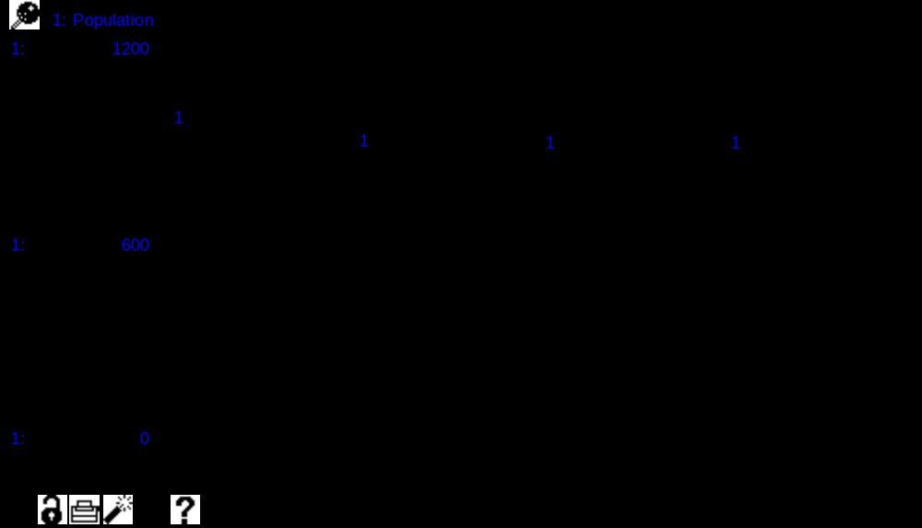
Example 4 Graph

Slide 15
Differential Equation 4
Stock_X(t) = Stock_X(t - dt) + (Flow_1 - Flow_2) * dt
(Stock_X(t) - Stock_X(t - dt))/dt = Flow_1 - Flow_2
    Flow_1 = Constant_a
    Flow_2 = Constant_b*
dX/dt = a - bX
Solution to DE:
?

Slide 16
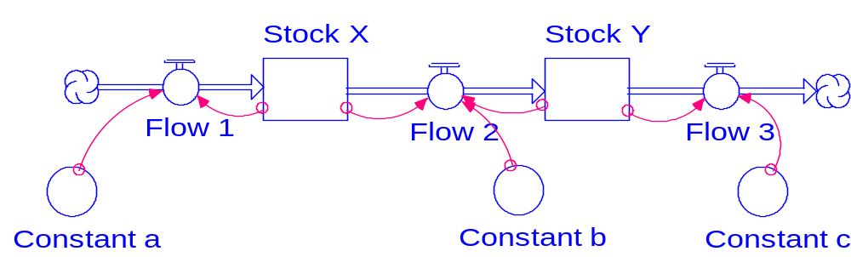
Calculus Example 5
STELLA Diagram
Two stocks, X and Y, and three flows.
The outflow from Stock X is the inflow to Stock Y.

Slide 17
STELLA Equations 5
Stock_X(t) = Stock_X(t - dt) + (Flow_1 - Flow_2) * dt
    INIT Stock_X = 100
    Flow_1 = Constant_a*Stock_X
    Flow_2 = Constant_b*Stock_X*Stock_Y
Stock_Y(t) = Stock_Y(t - dt) + (Flow_2 - Flow_3) * dt
    INIT Stock_Y = 100
    Flow_2 = Constant_b*Stock_X*Stock_Y
    Flow_3 = Constant_c*Stock_Y
    Constant_a = .2
    Constant_b = .001
    Constant_c = .01

Slide 18
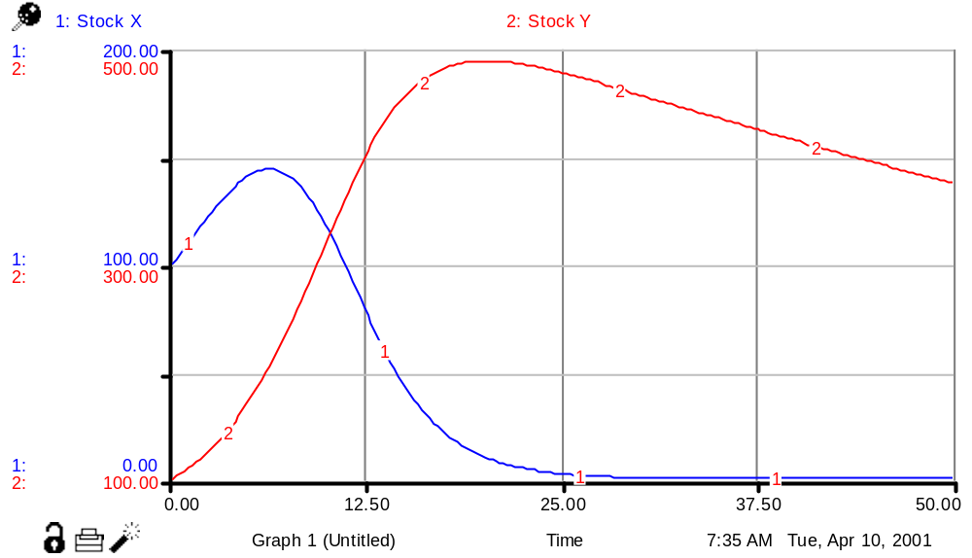
Example 5 Graph

Slide 19
Differential Equations 5
How many differential equations do we need?
(Stock_X(t) - Stock_X(t - dt))/dt
= Flow_1 - Flow_2
(Stock_Y(t) - Stock_Y(t - dt))/dt
= Flow_2 - Flow_3
dX/dt = aX - bXY
dY/dt = bXY - cY
(A pair of differential equations)

Slide 20
Differential Equations 6
dX/dt = -aXY
dY/dt = aXY- bY
dZ/dt = bY

Slide 21
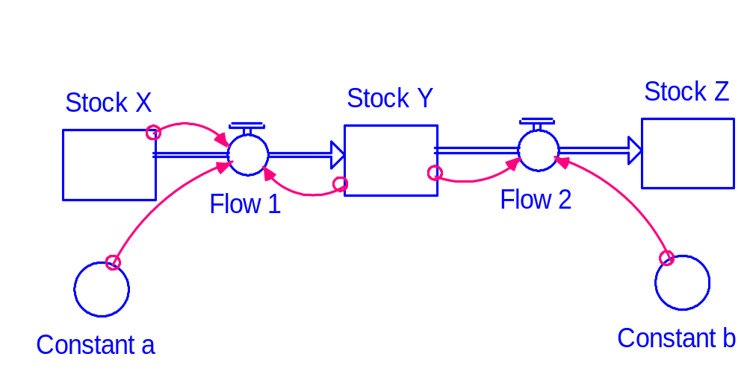
STELLA Diagram 6

Slide 22
STELLA Equations 6
Stock_X(t) = Stock_X(t - dt) + (- Flow_1) * dt
    Flow_1 = Constant_a*Stock_X*Stock_Y /dt
Stock_Y(t) = Stock_Y(t - dt) + (Flow_1 - Flow_2) * dt
    Flow_1 = Constant_a*Stock_X*Stock_Y
    Flow_2 = Constant_b*Stock_Y
Stock_Z(t) = Stock_Z(t - dt) + (Flow_2) * dt
    Flow_2 = Constant_b*Stock_Y

